Slide 1
Nonlinear Ray Tracing for Displacement and Shell Mapping Shinji Ogaki
Notes:
Thank you for the introduction. I'd like to present a nonlinear ray tracing technique for displacement and shell mapping.

Slide 2
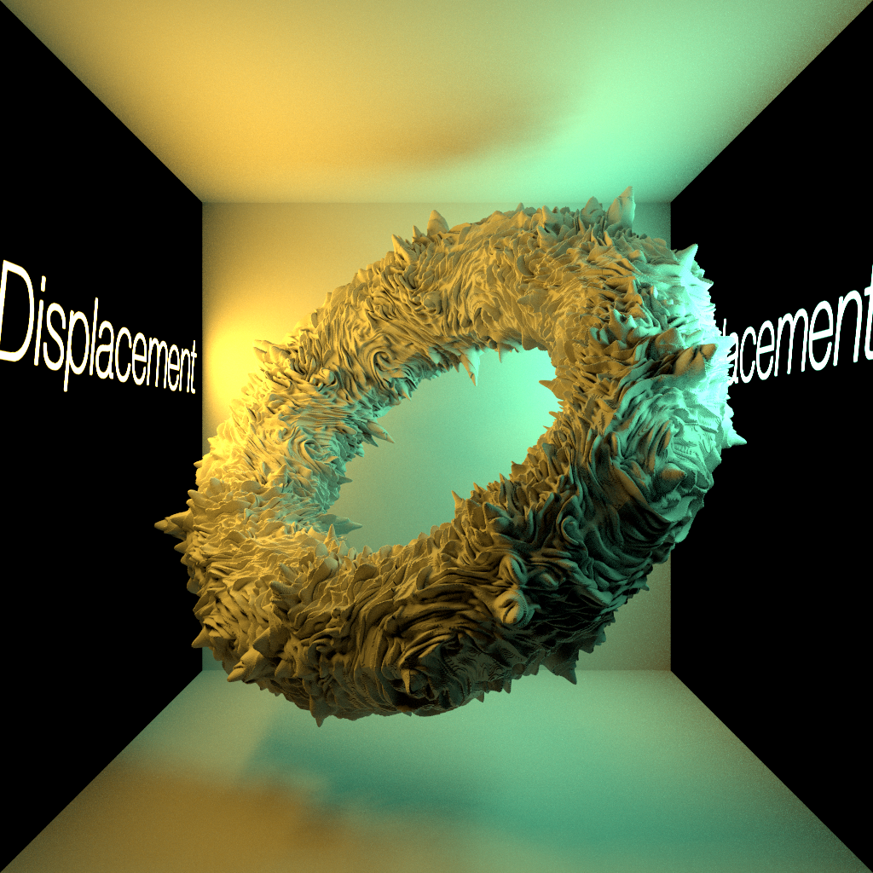
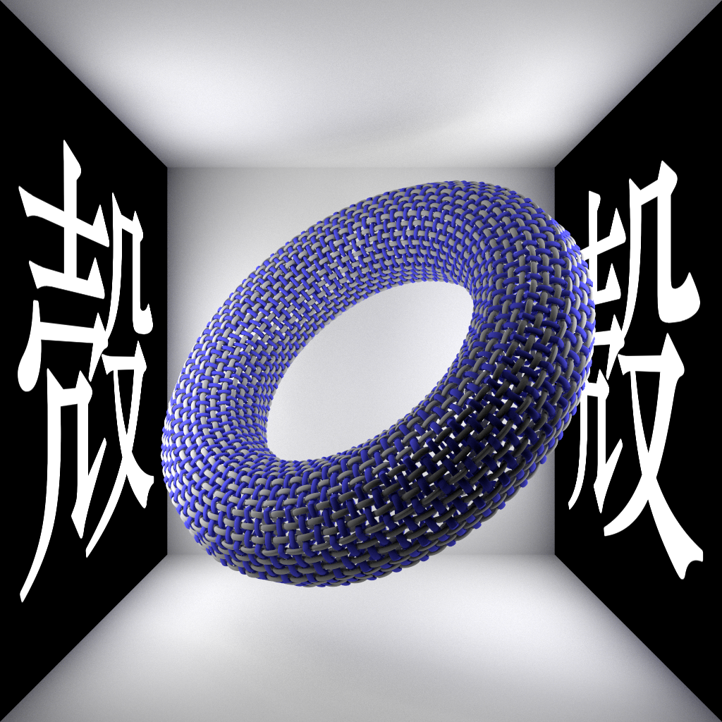
Notes:
Displacement mapping maps a height field, and shell mapping maps arbitrary geometry to a 3D surface as shown here.

Slide 3
Displacement Mapping & Shell Mapping
Requirements:
High ray tracing performance
Low memory footprint
Interactive feedback
Ease of implementation
Not easy because
Rays in texture space become nonlinear
Notes:
They are very powerful tools. However, it is not easy to simultaneously achieve high ray tracing performance, low memory footprint, interactive feedback, and ease of implementation partly because rays in world space are nonlinear in texture space.

Slide 4
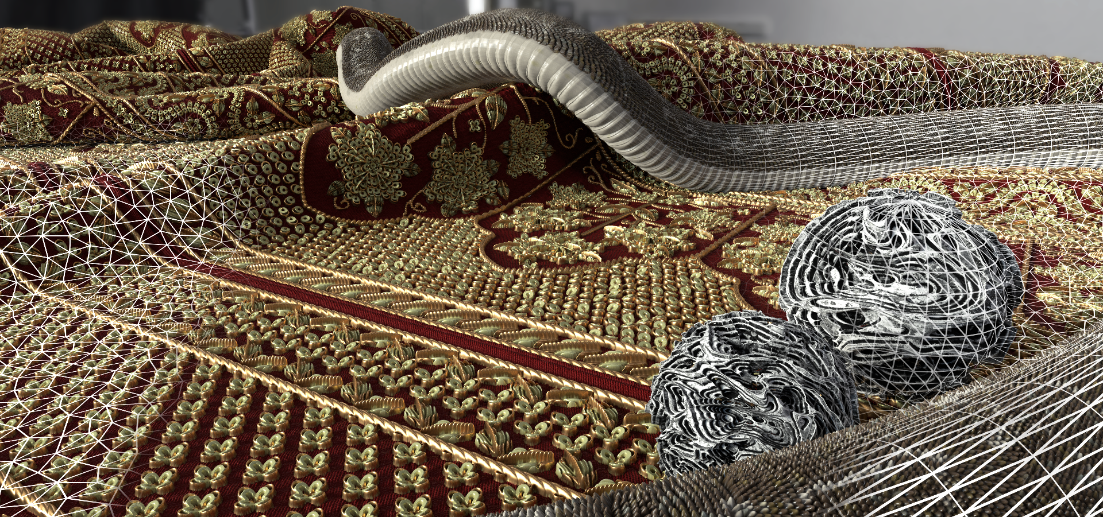
TFDM (Tessellation-Free Displacement Mapping)
[Thonat et al. 2021]
Notes:
Recently proposed tessellation-free displacement mapping, TFDM for short, can render detailed geometry with a small amount of memory. TFDM gives impressive results but is rather complex, at least for me.

Slide 5
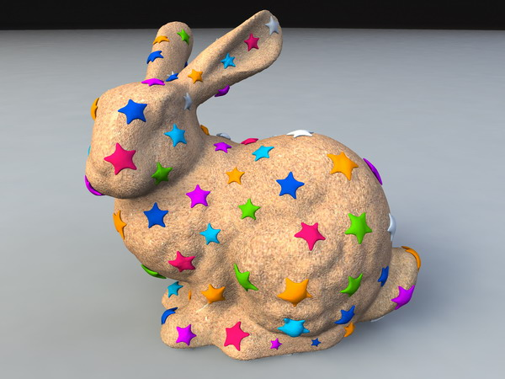
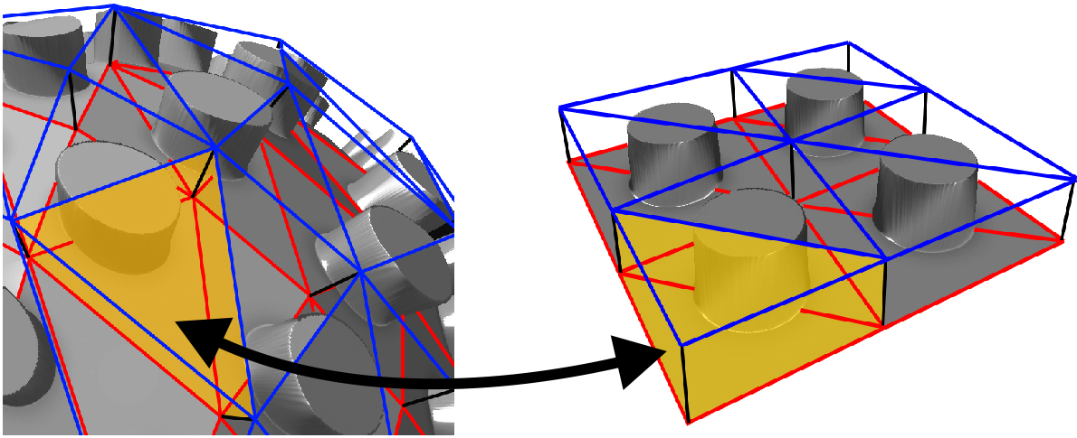
Shell Mapping
[Jeschke et al. 2007]
[Porumbescu et al. 2005]
Notes:
Existing shell mapping algorithms use ray marching optionally with a distance map. They are not very efficient, and as far as I know, shell mapping is not yet a standard feature of production renderers.

Slide 6
Goals
Simpler TFDM (tessellation-free displacement mapping)
Make shell mapping more practical
Notes:
Therefore, the goals of this work are set to simplify TFDM and to bring shell mapping one step closer to practical use.

Slide 7
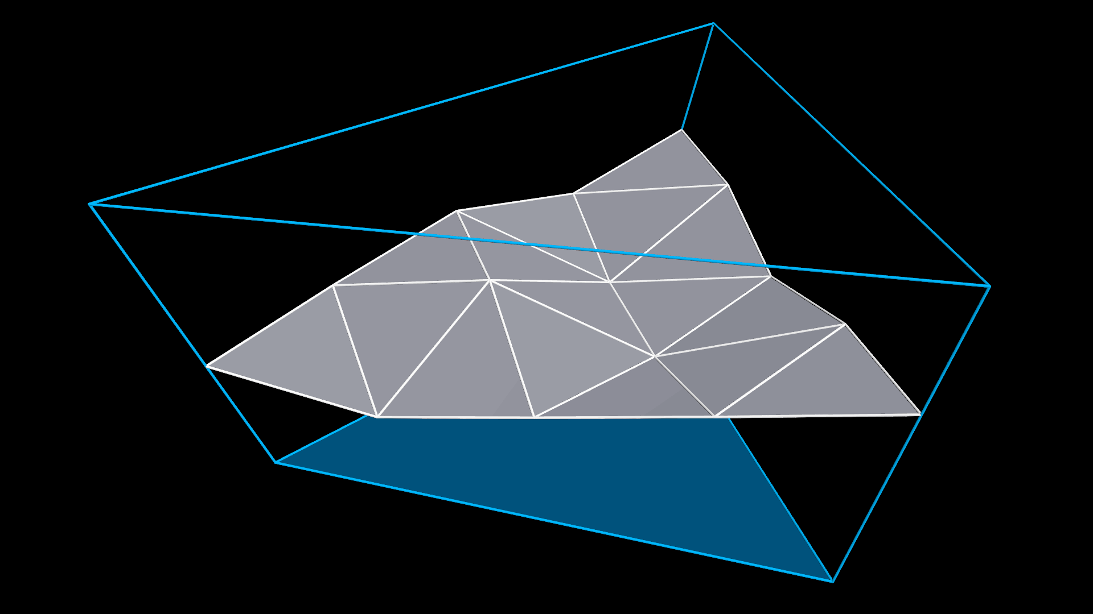





Shell Space $\left(α,β,h\right)$
Offset mesh triangle
$$N_{2}$$
$$N_{0}$$
$$N_{1}$$
$$P_{0}$$
Base mesh triangle
$$P_{1}$$
Notes:
So, what is “shell”? Shell is a layer between a base mesh and its offset mesh. In this shell space, displacement mapping creates a height field and shell mapping creates instances of arbitrary objects.

Slide 8

Shell Space $\left(α,β,h\right)$
Offset mesh triangle
$$N_{2}$$
$$S_{i}\left(h\right)=P_{i}+hN_{i}$$
$$S\left(α,β,h\right)=\left(1−α−β\right)S_{0}\left(h\right)+αS_{1}\left(h\right)+βS_{1}\left(h\right)$$
$$N_{0}$$
$$N_{1}$$
$$P_{0}$$
Base mesh triangle
$$P_{1}$$
Notes:
The coordinates of a point in the prism bounded by a base mesh triangle and its corresponding offset mesh triangle can be represented using alpha, beta, and h. P is a vertex position of the base mesh triangle, N is an unnormalized vertex normal,

Slide 9
Shell Space $\left(α,β,h\right)$
Height depends on UV
Offset mesh triangle
$$N_{2}$$
$$S_{i}\left(h\right)=P_{i}+hN_{i}$$
$$S\left(α,β,h\right)=\left(1−α−β\right)S_{0}\left(h\right)+αS_{1}\left(h\right)+βS_{1}\left(h\right)$$
$$N_{0}$$
$$N_{1}$$
$$P_{0}$$
Barycentric coordinates of base triangle
Base mesh triangle
$$P_{1}$$
Notes:
alpha and beta are the barycentric coordinates, and h is a height normalized from 0 to 1.

Slide 10
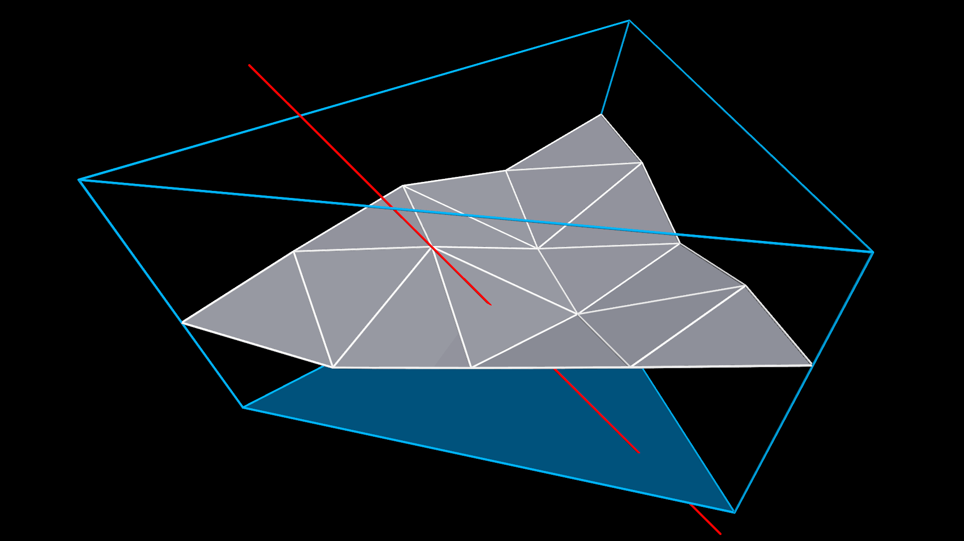
Nonlinear Ray
Notes:
Each vertex of the base mesh triangle has its UV coordinates, and when the prism is converted from world space to texture space, a straight ray piercing the prism becomes nonlinear.

Slide 11



Nonlinear Ray
$$\hat{ω}$$
$$o$$
$$o+\hat{ω}t =\left(1−α−β\right)S_{0}\left(h\right)+αS_{1}\left(h\right)+βS_{1}\left(h\right)$$
Ray
Notes:
To perform intersection tests entirely in texture space, we need to solve this equation. Here, o is the viewpoint, ω is the ray direction, and t is the distance to an intersection point.

Slide 12

Nonlinear Ray
$$\hat{ω}$$
$$o$$
$$o+\hat{ω}t =\left(1−α−β\right)S_{0}\left(h\right)+αS_{1}\left(h\right)+βS_{1}\left(h\right)$$
Notes:
The main finding of this work is that acceleration structure traversal becomes easy when a ray is represented as a function of h.

Slide 13
Nonlinear Ray
$$\hat{ω}$$
$$o$$
$$o+\hat{ω}t =\left(1−α−β\right)S_{0}\left(h\right)+αS_{1}\left(h\right)+βS_{1}\left(h\right)$$
Notes:
So, I’d like to remove this distance parameter t from the equation.

Slide 14

Nonlinear Ray
$$\hat{ω}$$
$$o$$
$$o+\hat{ω}t =\left(1−α−β\right)S_{0}\left(h\right)+αS_{1}\left(h\right)+βS_{1}\left(h\right)$$
$\hat{ω}⊥$ $e_{0}$, $\hat{ω}⊥$ $e_{1}$, $e_{0}⊥$ $e_{1}$
$$\begin{aligned}\left\langle e_{0}, S_{1}\left(h\right)−S_{0}(h)\right\rangle α+\left\langle e_{0},S_{2}\left(h\right)−S_{0}(h)\right\rangle β=\left\langle e_{0}, o−S_{0}(h)\right\rangle \\ \left\langle e_{1},S_{1}\left(h\right)−S_{0}(h)\right\rangle α+\left\langle e_{1},S_{2}\left(h\right)−S_{0}(h)\right\rangle β=\left\langle e_{1}, o−S_{0}(h)\right\rangle \end{aligned}$$
Notes:
By taking dot products on the both sides with two vectors e0 and e1 orthogonal to ω, we obtain these simultaneous equations.

Slide 15

Nonlinear Ray
$$I\left(α,β,h\right)=\left(\frac{α_{2}h^{2}+α_{1}h+α_{0}}{dh^{2}+d_{1}h+d_{0}},\frac{β_{2}h^{2}+β_{1}h+β_{0}}{dh^{2}+d_{1}h+d_{0}},h\right)$$
Notes:
Solving them for alpha and beta, the ray can be expressed with quadratic rational functions of h. The source code is available, so please don’t worry about these coefficients. By applying a linear transformation to this,

Slide 16

Nonlinear Ray
$$I\left(u,v,h\right)=\left(\frac{u_{2}h^{2}+u_{1}h+u_{0}}{dh^{2}+d_{1}h+d_{0}},\frac{v_{2}h^{2}+v_{1}h+v_{0}}{dh^{2}+d_{1}h+d_{0}},h\right)$$
Notes:
the ray in texture space can also be represented by quadratic rational functions.

Slide 17
Nonlinear Ray
Eliminates
Affine arithmetic
Matrix inversions for texture to world-space mappings
Ray marching
Notes:
There are multiple reasons for using the rational function form. Nonlinear ray tracing eliminates the need for affine arithmetic to compute conservative bounding boxes and matrix inversions used in TFDM. It also eliminates ray marching from shell mapping.

Slide 18

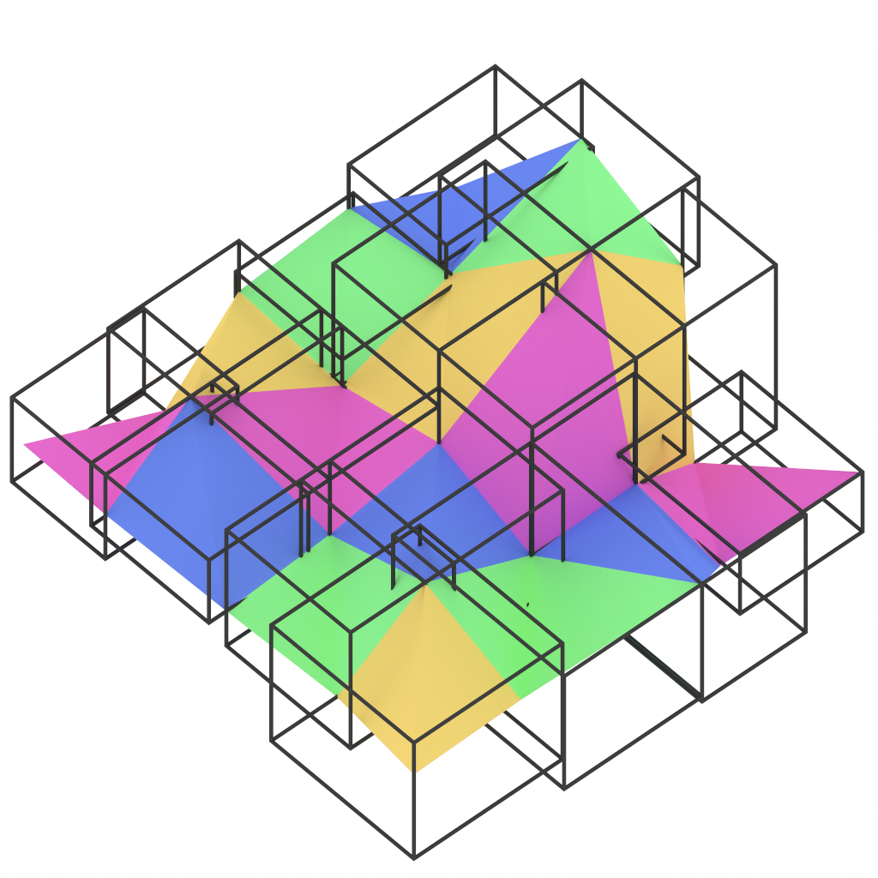
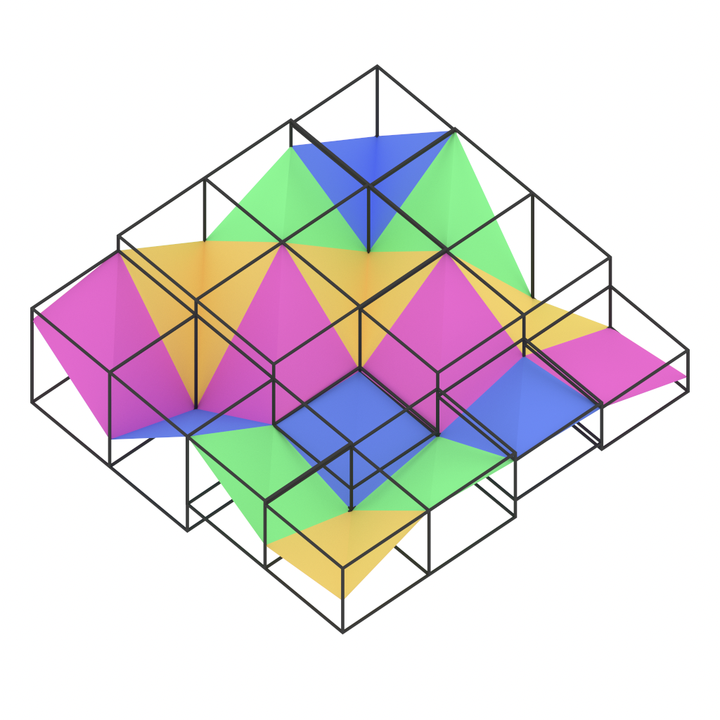
Tight Bounding Boxes (No Affine Arithmetic)
Base mesh
World space
Texture space
Notes:
The axis-aligned bounding boxes of tiny triangles generated by a displacement map overlap in world space but not in texture space. Therefore, there is no need to use affine arithmetic.

Slide 19
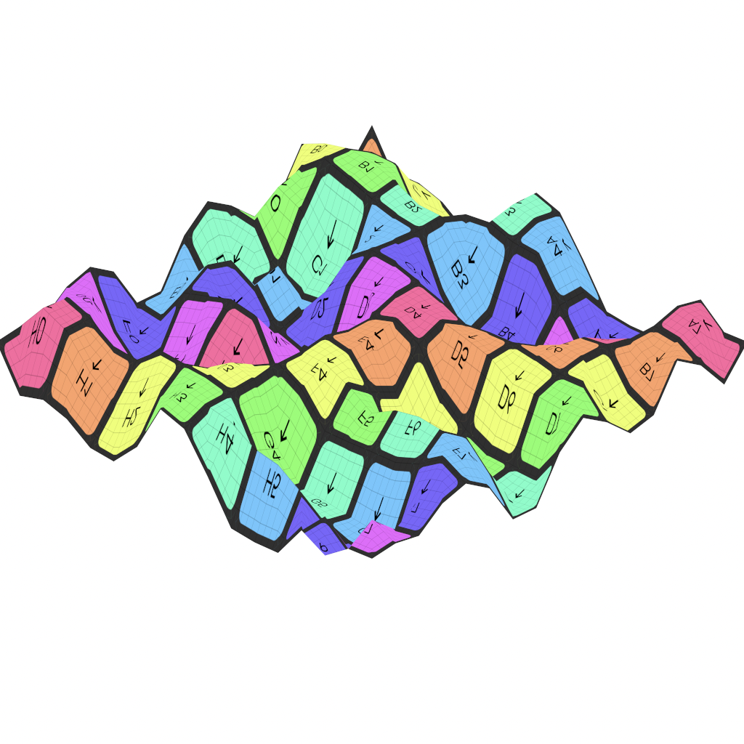
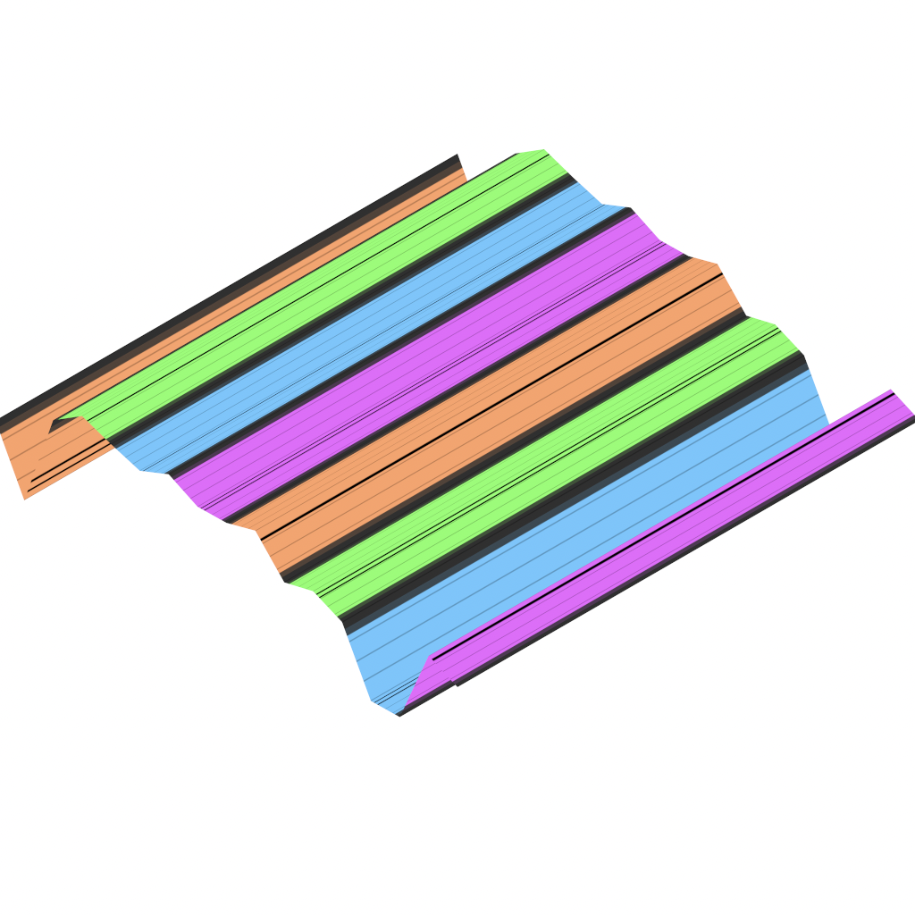

Degenerated in Texture Space (No Matrix Inversion)
Rectangle
Line
Point
Notes:
With nonlinear rays, we can render geometry in a shell even if the base mesh triangle is degenerated in texture space because matrix inversions are no longer used.

Slide 20
Two-Level Acceleration Structure
TLAS (Top-level acceleration structure)
BVH built for prisms
BLAS (Bottom-level acceleration structure)
TFDM (Tessellation-free displacement mapping)
Minmax mipmap
Each leaf stores 2 triangles
Shell mapping
Implicit quadtree
Each leaf stores a reference to an object to be instanced
Notes:
The acceleration structure is two-level. [click] The top-level acceleration structure is a BVH built over prisms.[click] TFDM uses minmax mipmap [click] and shell mapping uses implicit quadtree as the bottom level acceleration structure. Each leaf of the quadtree stores the reference to an object to be instanced.

Slide 21


Nonlinear Ray-AABB Intersection
$$U$$
$$I\left(u,v,h\right)=\left(\frac{u_{2}h^{2}+u_{1}h+u_{0}}{dh^{2}+d_{1}h+d_{0}},\frac{v_{2}h^{2}+v_{1}h+v_{0}}{dh^{2}+d_{1}h+d_{0}},h\right)$$
$$U=\frac{u_{2}h^{2}+u_{1}h+u_{0}}{dh^{2}+d_{1}h+d_{0}}$$
Easy to solve by clearing the denominator!
Notes:
Nonlinear ray-AABB intersection test is done by finding the intersections of each face of an AABB and nonlinear ray. For example, for a plane whose U-coordinate is constant, we just need to solve this quadratic equation. This way, acceleration structure traversal can be performed robustly.

Slide 22

Nonlinear Ray-Triangle Intersection
$$I\left(u,v,h\right)=\left(\frac{u_{2}h^{2}+u_{1}h+u_{0}}{dh^{2}+d_{1}h+d_{0}},\frac{v_{2}h^{2}+v_{1}h+v_{0}}{dh^{2}+d_{1}h+d_{0}},h\right)$$
$$n_{u}u+n_{v}v+n_{h}h+C=0$$
Notes:
The intersections of a nonlinear ray and triangle can be found by substituting rational functions into a plane equation defined in texture space. This time we need to solve a cubic equation obtained by clearing the denominators.

Slide 23
Nonlinear Ray Tracing
Acceleration data structure traversal → quadratic equation
Nonlinear ray-triangle intersection test → cubic equation
Notes:
To briefly summarize, we need to solve quadratic equations for acceleration structure traversal, and cubic equations for ray-triangle intersection tests. So, the proposed method is surprisingly simple.

Slide 24
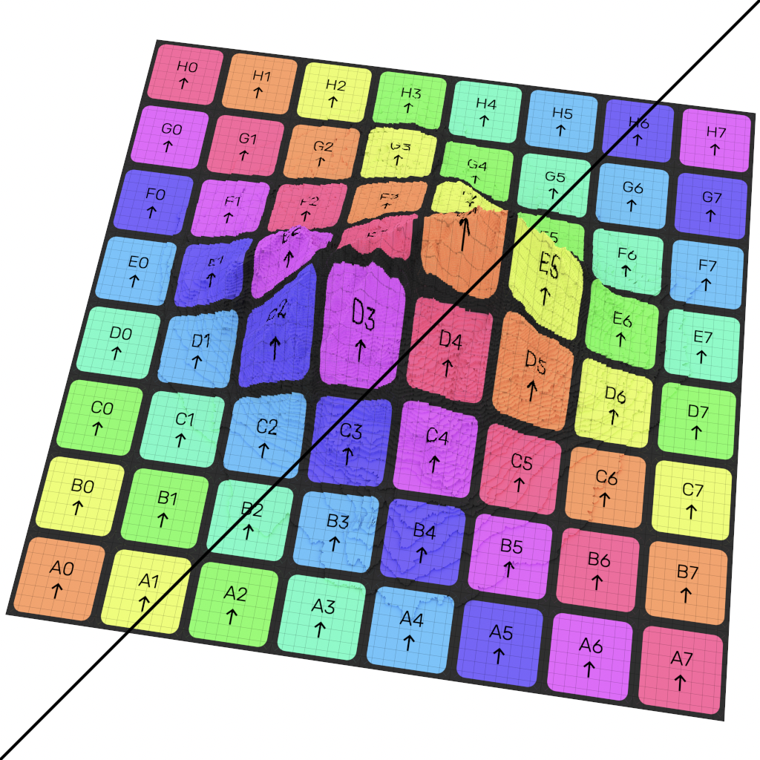
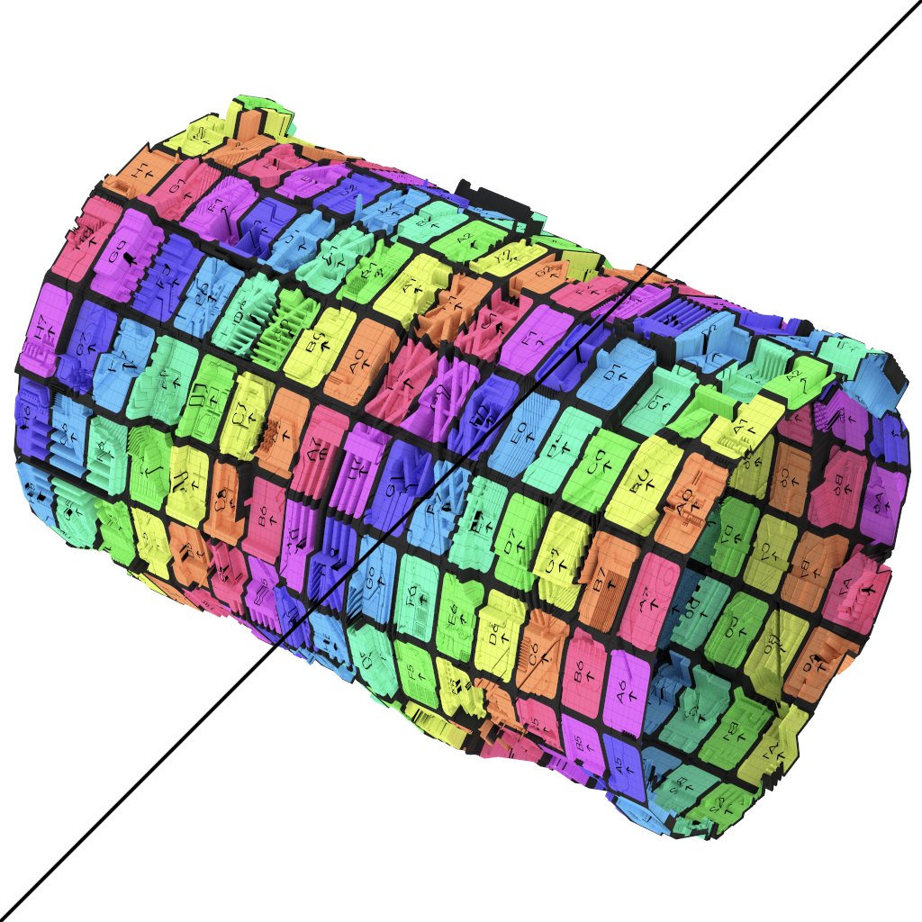
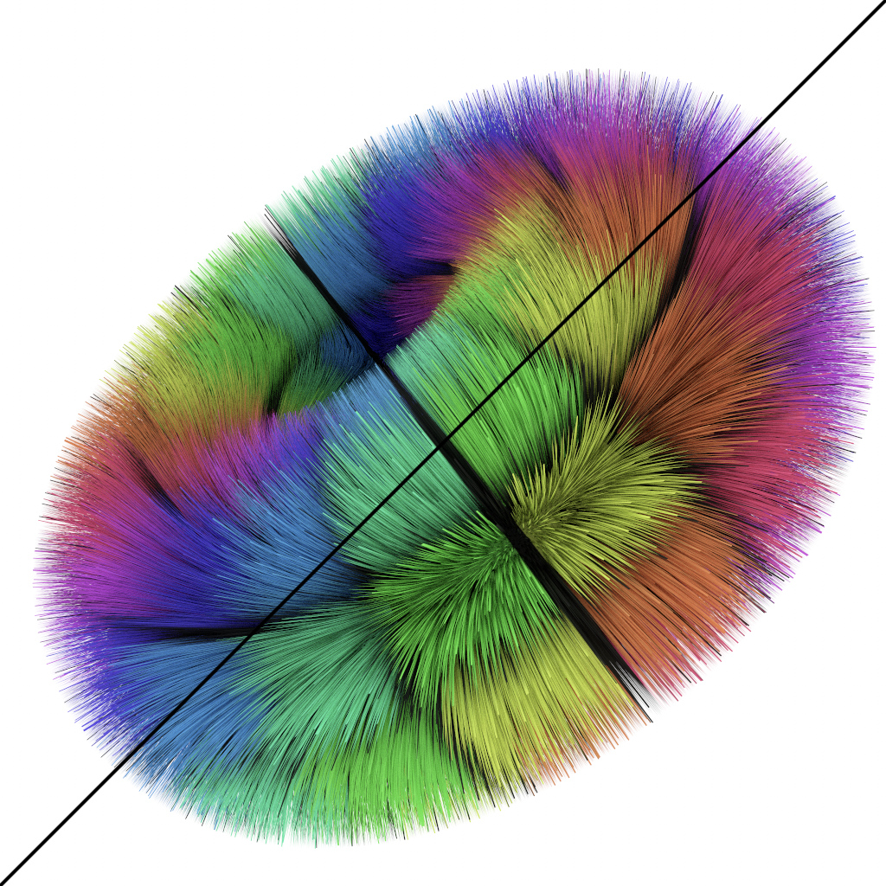
Results - Displacement Mapping
Pretessellation 24.92 Mrays/sec
Pretessellation 23.64 Mrays/sec
Pretessellation 0.49 Mrays/sec
Ours 7.74 Mrays/sec
Ours 5.0 Mrays/sec
Ours 1.09 Mrays/sec
Notes:
Now, I’ll show some results. Here, the proposed method was compared against displacement mapping by pre-tessellation. The proposed method achieves from 20 to 30% of the speed of the rendering of the pre-tessellated geometry. The fur geometry on the right is an exception, where the proposed method achieves about twice the speed. This is because the axis-aligned bounding boxes in texture space behave as oriented bounding boxes in world space.

Slide 25
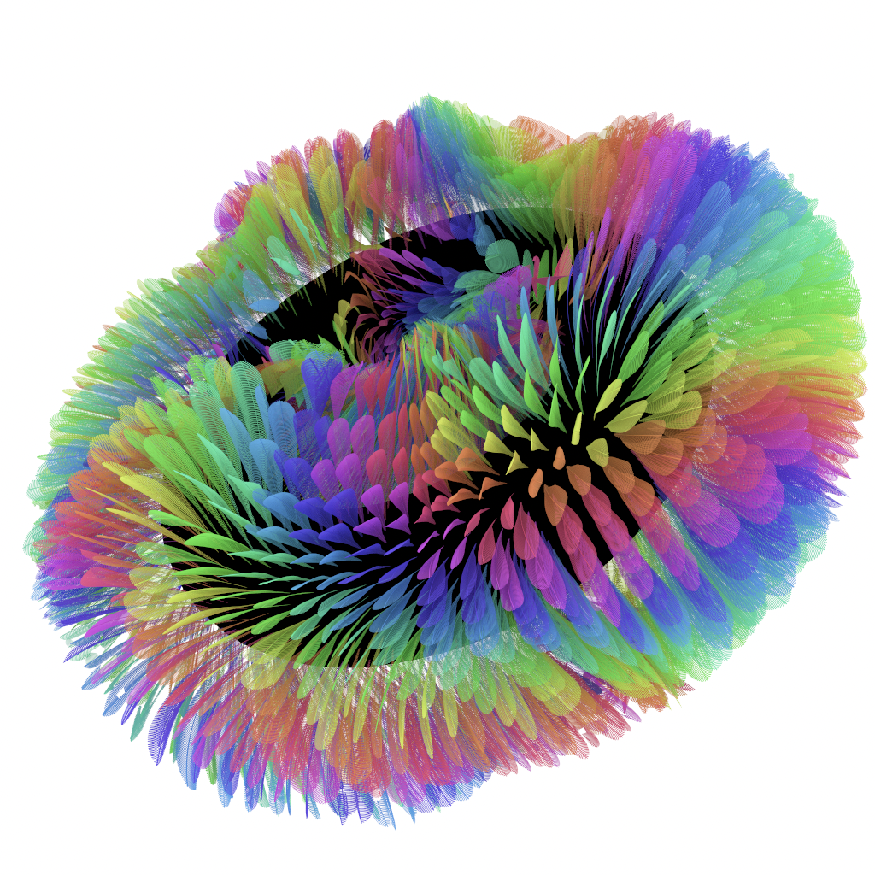
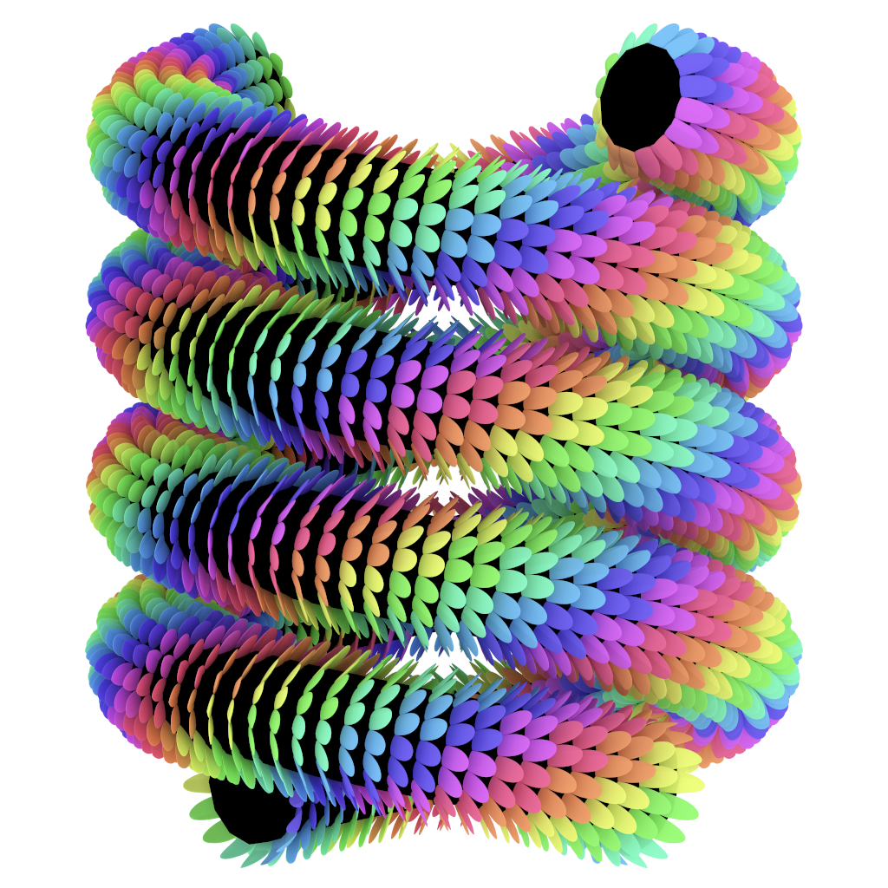
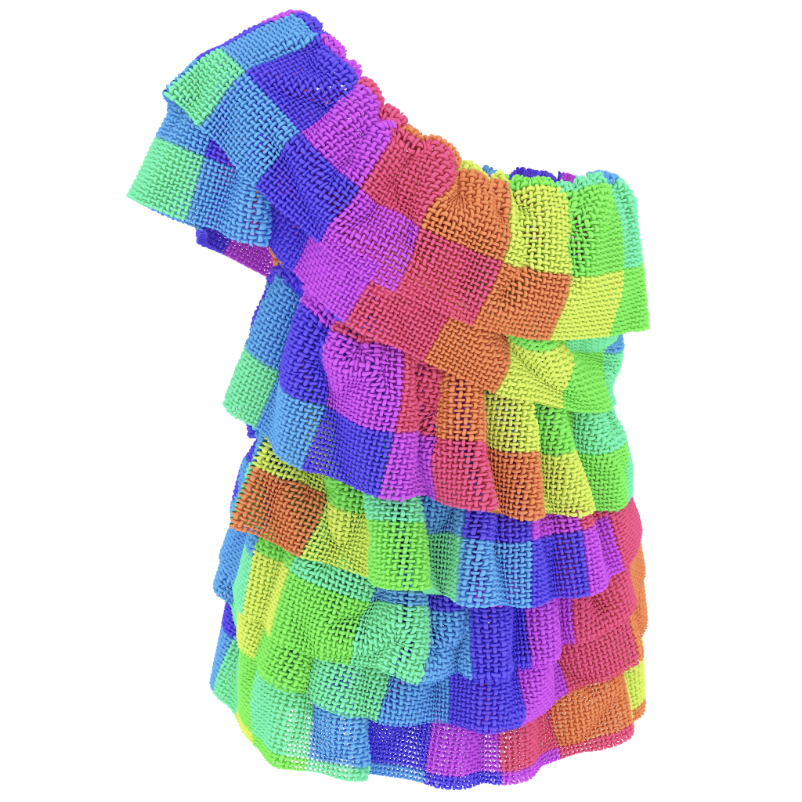
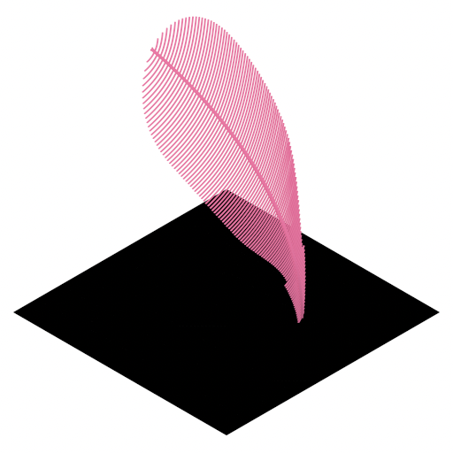
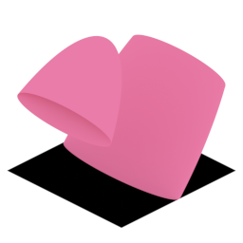
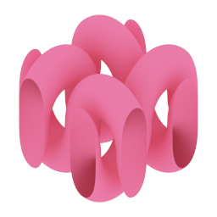
Results - Shell Mapping
1.0 Mrays/sec
2.11 Mrays/sec
2.06 Mrays/sec
Notes:
Next, shell mapped objects were rendered using the proposed method. The use of an implicit quadtree facilitates repeated placement of the same object along a mesh surface.

Slide 26
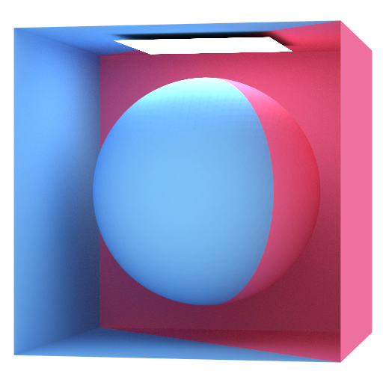
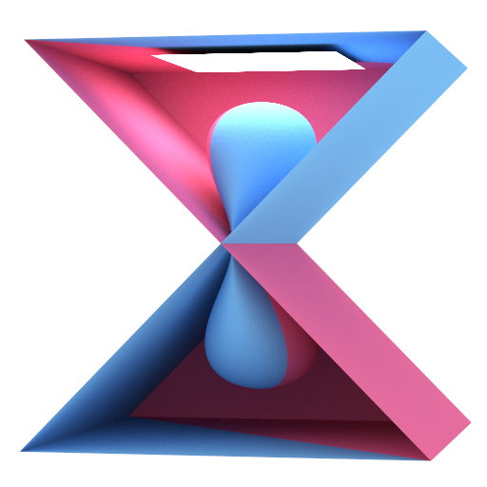
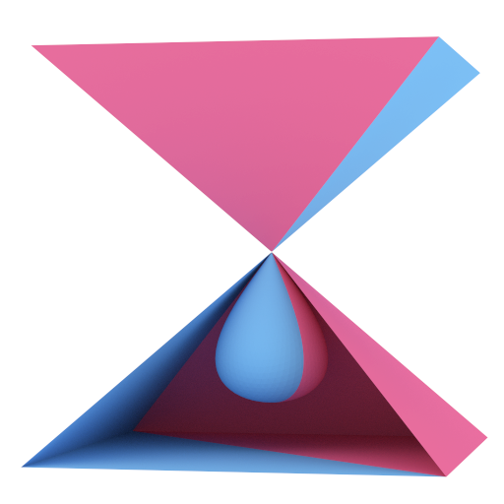
Self Intersection
Notes:
The method works even if the vertex normals are oriented to cause self-intersections.

Slide 27
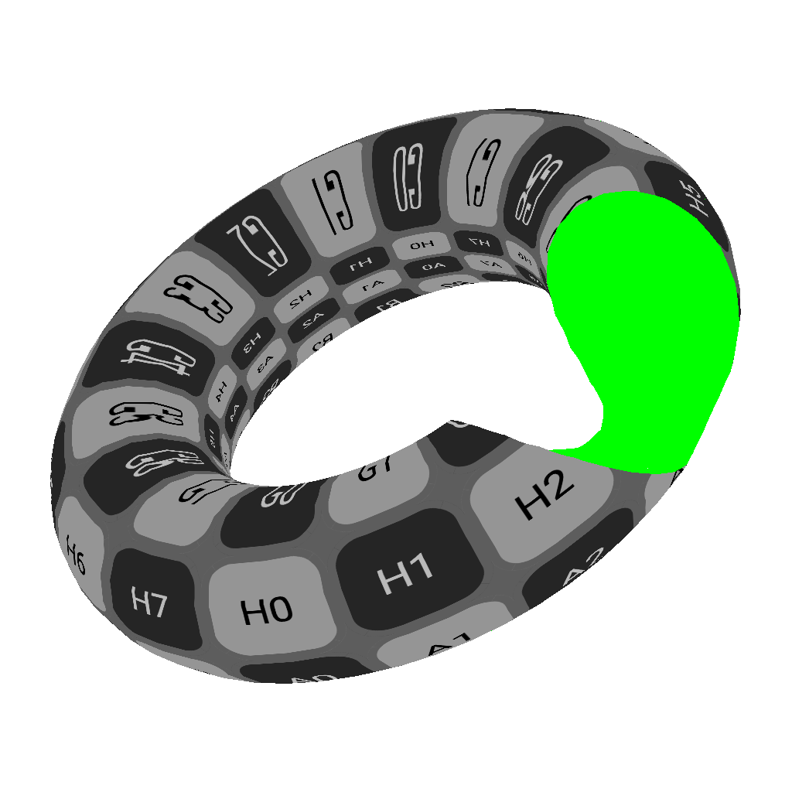
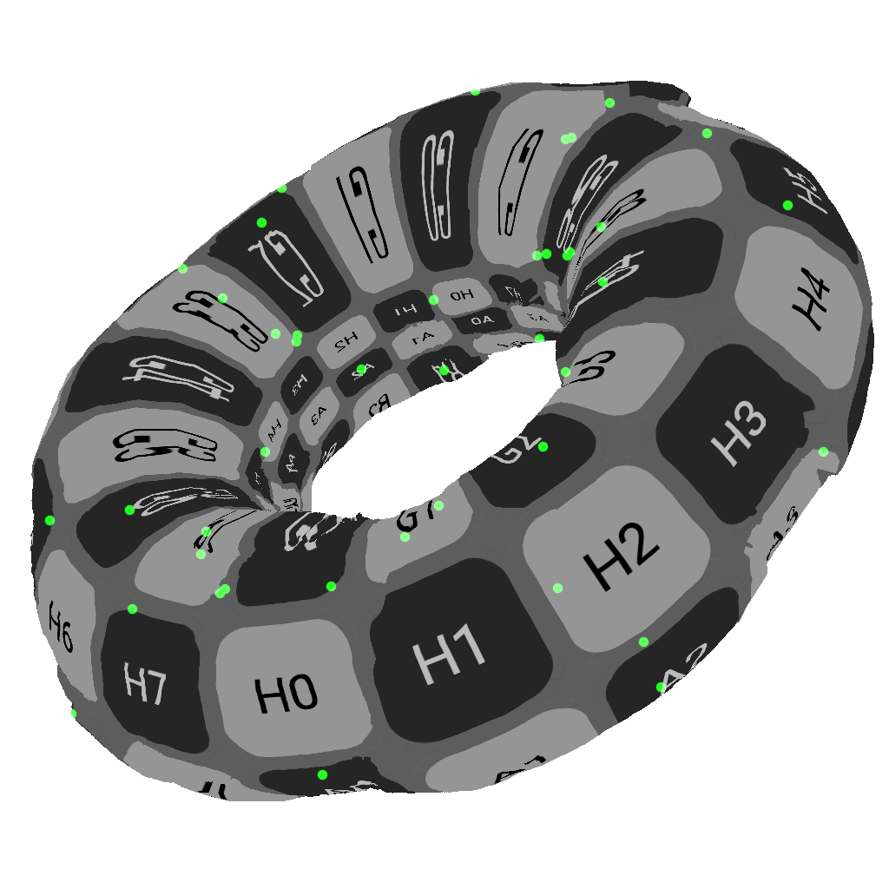
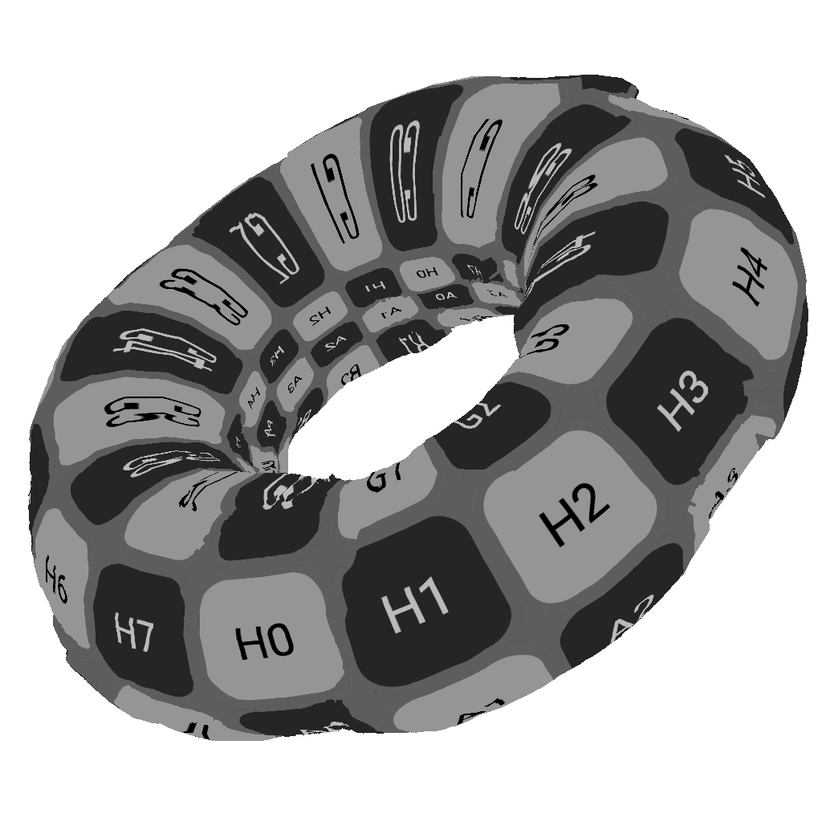
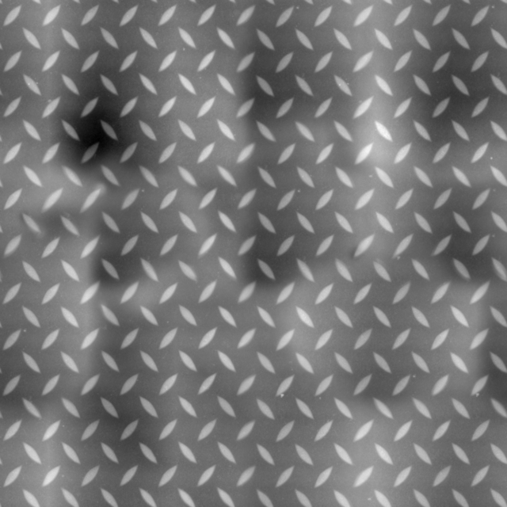
Limitations - Precision Issues
Single precision
Double precision
Notes:
Unfortunately, the proposed method has some limitations. In this test, displacement mapping is applied to a torus, and a bright green luminescent material is assigned to the back surface to see if watertightness is guaranteed. With single precision, some rays slip through the geometry. Switching to double precision prevents this issue, but there is no guarantee that perfect results will always be obtained.

Slide 28
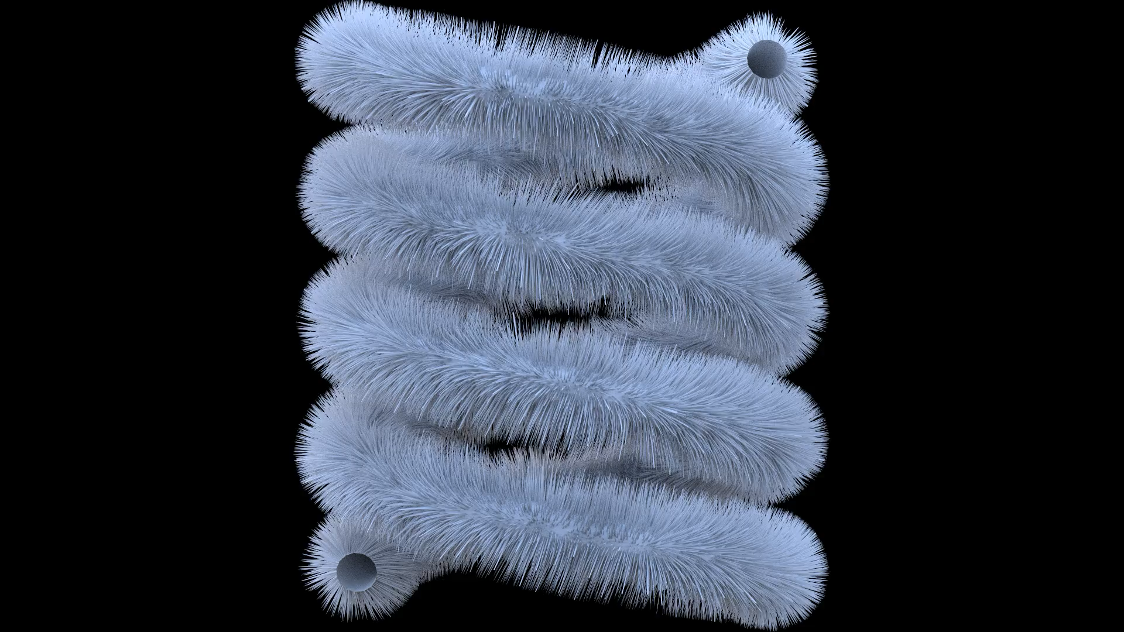
Limitations - Vector Displacement Mapping
Notes:
The proposed method does not support vector displacement mapping, however, this kind of animation can be created by moving vertex normals.

Slide 29
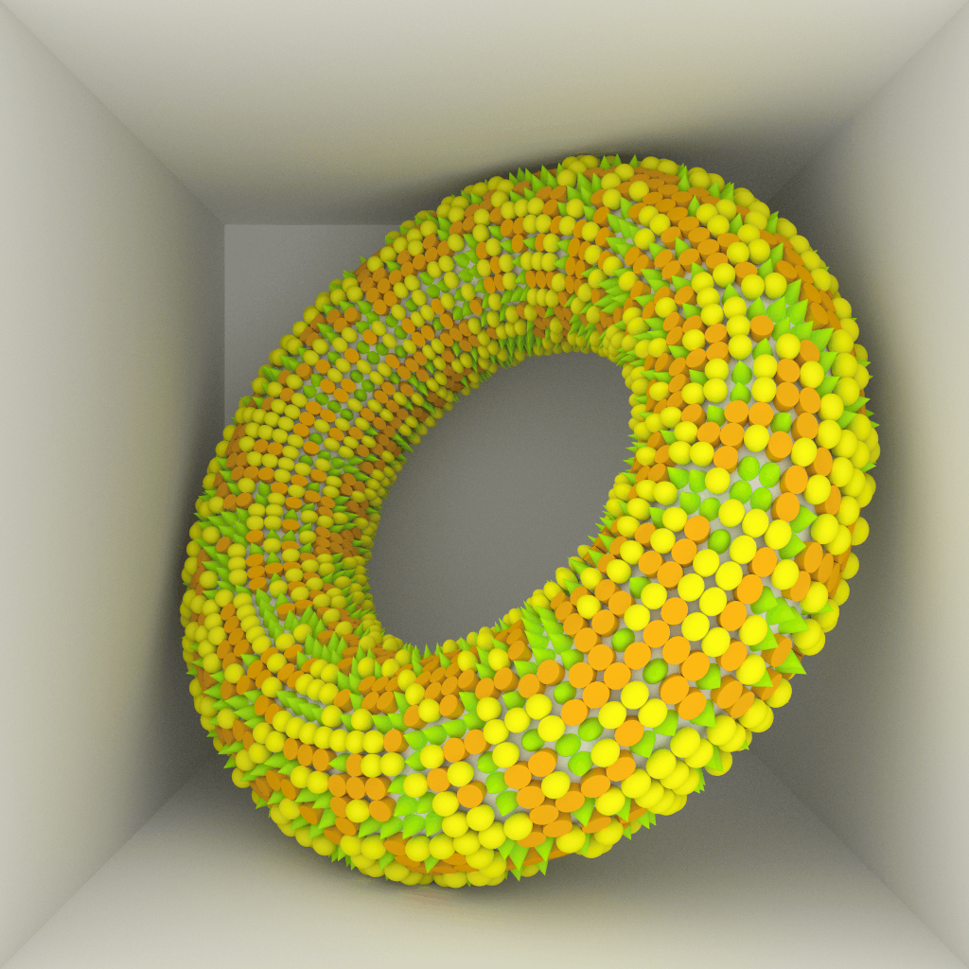
Conclusion
Introduced a simple method that can render both
displacement-mapped objects
shell-mapped objects
Various techniques developed for the BVH can be applied
Programmable instance
Hierarchical mesh quantization
Spatial-temporal BVH
Notes:
To conclude, a simple algorithm for displacement mapping and shell mapping is presented. Although it has some limitations, the method is intuitive and can efficiently render highly detailed geometry with a small memory footprint. A major advantage of the proposed method is that a variety of techniques developed for the BVH such as programmable instance can be applied because the BVH is used as an acceleration data structure.

Slide 30
Acknowledgements
Anonymous reviewers
Brian Budge
Marcos Fajardo
Yuki Ozawa
Kentaro Suzuki
Notes:
I’d like to thank anynymous reviewers, Brian Budge, Marcos Fajardo, Yuki Ozawa, Kentaro Suzuki, and my wife who purchased a full conference ticket just to see my presentation.

Slide 31
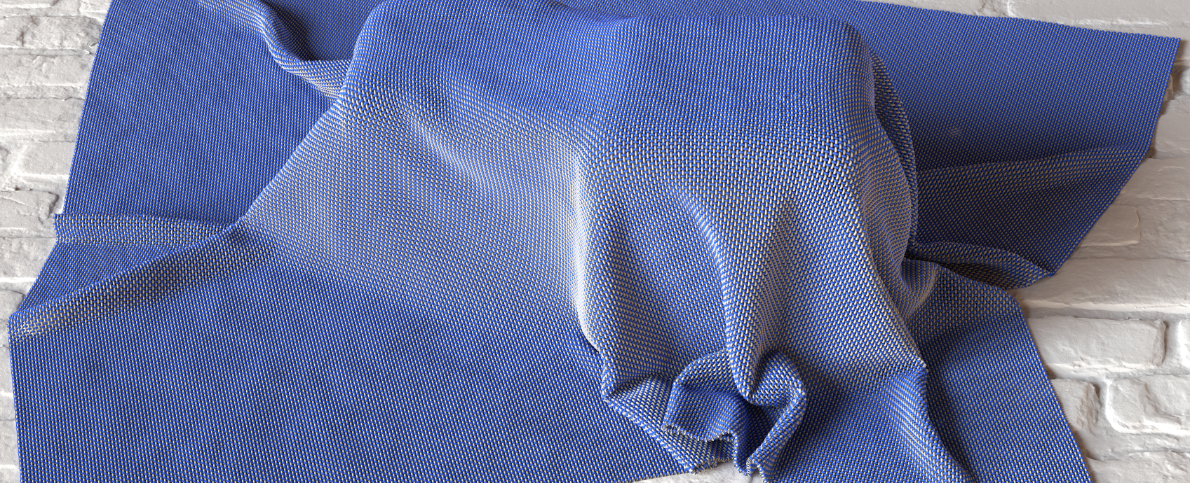

Thank you!
https://github.com/shinjiogaki/nonlinear-ray-tracing
Notes:
Thank you for your attention.

